Slide 1

SESSION 11
Valuation & Forecasting 1
SCALER SCHOOL OF TECHNOLOGY

Slide 2
Learning Outcomes
Session 11: Valuation & Forecasting – 1
By the end of the session, learners will be able to:
  Explain free cash flow (FCF), FCFF, FCFE, DCF, and valuation multiples.
  Differentiate FCFF from FCFE and P/E from Enterprise Value multiples.
  Calculate FCFF and FCFE from basic financial data.
  Apply DCF and multiples-based approaches to estimate company value.
  Compare FCFF and FCFE valuations and the impact of capital structure.
  Analyze how discount rates, growth assumptions, and multiples affect valuation.

Slide 3
Valuation & Forecasting
Valuation is the process of estimating the economic value of an asset, business, or company.
The value of an asset = The present value of the future economic benefits that investors expect to receive from it.
Valuation is based on:
Future cash flows
Earnings
Growth prospects
Risk
Capital requirements – debt or equity
Market valuations of comparable companies

Slide 4
Valuation & Forecasting
Approaches to Valuation
There are two broad ways of thinking about valuation.
Intrinsic valuation – What are the company's future cash flows worth today?
Relative Valuation – How much are similar companies being valued by the market?
Uses of Valuation:
Investment decisions
Mergers & Acquisitions (M&A)
Initial Public Offer (IPO) pricing
Sale or Purchase of Business
Strategic decisions
It is important to note that Market Price ≠ Intrinsic Value
Market price is the price at which the asset is trading.
Intrinsic value is an estimate based on the inherent strength of an asset, i.e., its ability to generate future cash flows.

Slide 5
Valuation & Forecasting
Factors that affect the Value of a Business:
Cash flows: How much cash can the business generate?
Growth: How quickly can cash flows grow?
Risk: How uncertain are future cash flows?
Investment requirements: How much must the company reinvest?
Capital structure: How much debt and equity does the company use?
Terminal value: What is the value of the business beyond the explicit forecast period?

Slide 6
Free Cash Flow (FCF)
Accounting profit measures performance; free cash flow focuses on cash available after necessary investment.
Free Cash Flow (FCF) is the cash generated by a business after making the investments required to maintain and grow the business.
FCF = Operating Cash Flow − Capital Expenditure

Slide 7
Free Cash Flow (FCF)
ABC Manufacturing Ltd. reports the following for FY2026.
Particulars | ₹ crore
Net Profit after Tax | 1,000
Depreciation | 200
Increase in Inventory | 100
Increase in Trade Receivables | 50
Increase in Trade Payables | 40
Capital Expenditure – machinery | 300
At first glance, it seems that the company earned ₹1,000 crore, so it has ₹1,000 crore available to distribute.
However, due to accrual accounting & other adjustments, that Cash ≠ Profit

Slide 8
Free Cash Flow (FCF)
The company reports a Net Profit of ₹1,000 crore.
Particulars | ₹ crore
Net Profit after Tax | 1,000
Depreciation | 200
Increase in Inventory | 100
Increase in Trade Receivables | 50
Increase in Trade Payables | 40
Capital Expenditure – machinery | 300
But net profit is an accounting measure, not a direct measure of cash generated. It needs to be adjusted
Add back Depreciation of ₹200 crore, as no cash is paid for charging depreciation.
Therefore, we add depreciation back to profit: ₹1,000 + ₹200 = ₹1,200 crore

Slide 9
Free Cash Flow (FCF)
The company reports a Net Profit of ₹1,000 crore.
Particulars | ₹ crore
Net Profit after Tax | 1,000
Depreciation | 200
Increase in Inventory | 100
Increase in Trade Receivables | 50
Increase in Trade Payables | 40
Capital Expenditure – machinery | 300
Adjustment for Working Capital:
Working capital generally includes items such as:
Inventory
Trade receivables
Trade payables
The key question is: Did the change in working capital consume cash or generate cash?
Increase in Inventory = cash outflow
Therefore, ₹100 crore to be subtracted: ₹1,200 - ₹100 = ₹1,100 crore

Slide 10
Free Cash Flow (FCF)
The company reports a Net Profit of ₹1,000 crore.
Particulars | ₹ crore
Net Profit after Tax | 1,000
Depreciation | 200
Increase in Inventory | 100
Increase in Trade Receivables | 50
Increase in Trade Payables | 40
Capital Expenditure – machinery | 300
Adjustment for Trade Receivables:
Trade receivables increased by ₹50 crore. It signifies that the company has made sales to customers but has not yet collected the cash.
Therefore, the increase in receivables represents cash that is temporarily tied up with customers.
Increase in Receivables = cash outflow
Therefore, ₹50 crore to be subtracted: ₹1,100 - ₹50 = ₹1,050 crore

Slide 11
Free Cash Flow (FCF)
The company reports a Net Profit of ₹1,000 crore.
Particulars | ₹ crore
Net Profit after Tax | 1,000
Depreciation | 200
Increase in Inventory | 100
Increase in Trade Receivables | 50
Increase in Trade Payables | 40
Capital Expenditure – machinery | 300
Adjustment for Trade Payables:
Trade payables increased by ₹40 crore. It signifies that the company has received goods/services but has not yet paid the supplier.
Therefore, the company has effectively retained ₹40 crore of cash.
the increase in receivables represents cash that is temporarily tied up with customers.
Increase in Payables = cash inflow
Therefore, ₹40 crore to be added: ₹ 1,050 = ₹40 = ₹1,090 crore

Slide 12
Free Cash Flow (FCF)
The company reports a Net Profit of ₹1,000 crore.
Particulars | ₹ crore
Net Profit after Tax | 1,000
Depreciation | 200
Increase in Inventory | 100
Increase in Trade Receivables | 50
Increase in Trade Payables | 40
Capital Expenditure – machinery | 300
Calculating Operating Cash Flow:
Particulars | ₹ crore | Cash-flow adjustment
Net Profit | 1,000 | Starting point
Add: Depreciation | +200 | Non-cash expense
Less: Increase in Inventory | −100 | Cash tied up
Less: Increase in Receivables | −50 | Cash not yet collected
Add: Increase in Payables | +40 | Cash retained
Operating Cash Flow | 1,090

Slide 13
Free Cash Flow (FCF)
The company reports a Net Profit of ₹1,000 crore.
Particulars | ₹ crore
Net Profit after Tax | 1,000
Depreciation | 200
Increase in Inventory | 100
Increase in Trade Receivables | 50
Increase in Trade Payables | 40
Capital Expenditure – machinery | 300
Adjustment for Capital Investment:
Company purchased a new machinery for ₹300 crore. This is capital expenditure (CapEx).
Unlike depreciation, CapEx represents an actual cash payment.
The company actually paid: ₹300 crore
Capital Expenditure = cash inflow
Therefore, ₹300 crore to be subtracted = ₹ 1,090 - ₹300 = ₹790 crore

Slide 14
Free Cash Flow (FCF)
The company reports a Net Profit of ₹1,000 crore.
Particulars | ₹ crore
Net Profit after Tax | 1,000
Depreciation | 200
Increase in Inventory | 100
Increase in Trade Receivables | 50
Increase in Trade Payables | 40
Capital Expenditure – machinery | 300
Free Cash Flow (FCF): Operating Cash Flow - Capital Expenditure
FCF = ₹ 1,090 - ₹300 = ₹790 crore

Slide 15
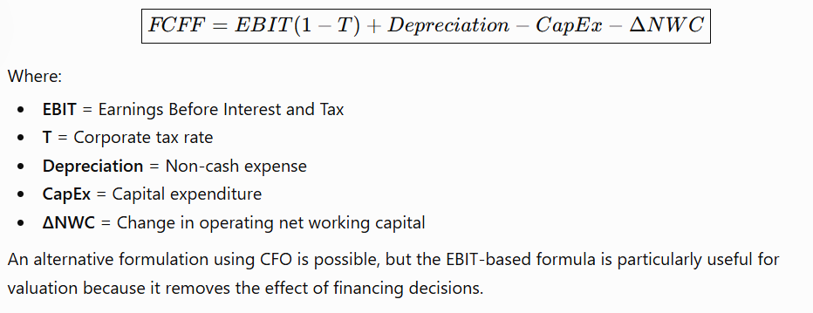
Free Cash Flow to Firm (FCFF)
Free Cash Flow to Firm (FCFF) is the cash generated by a company's operations that is available to all providers of capital:
Equity shareholders
Debt holders
It is the cash flow generated by the business before payments to debt providers and equity shareholders.

Slide 16
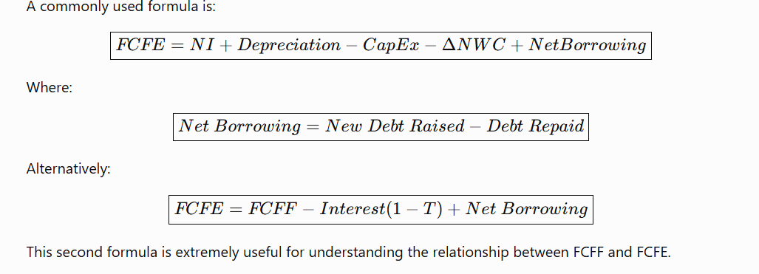
Free Cash Flow to Equity (FCFE)
Free Cash Flow to Equity (FCFE) measures the cash available specifically to equity shareholders after meeting the cash-flow consequences of debt financing.

Slide 17
Free Cash Flow to Equity (FCFE)
Example:
₹ crore | FY2020–21 | FY2021–22 | FY2022–23 | FY2023–24 | FY2024–25
Profit after tax | 33,388 | 38,449 | 42,303 | 46,099 | 48,797
Effective tax rate | 25.5% | 25.6% | 25.7% | 25.8% | 25.3%
EBIT margin | 25.9% | 25.3% | 24.1% | 24.6% | 24.3%
Revenue | 1,64,177 | 1,91,754 | 2,25,458 | 2,40,893 | 2,55,324
EBIT = Revenue × EBIT margin | 42,520 | 48,514 | 54,336 | 59,260 | 62,045
D&A | 4,929 | 5,337 | 5,586 | 4,985 | 5,242
Operating cash flow | 39,929 | 45,067 | 44,000 | 44,990 | 49,139
CapEx | 3,119 | 2,876 | 3,155 | 3,063 | 2,650
FCFF ≈ CFO − CapEx | 36,810 | 42,191 | 40,845 | 41,927 | 46,489
Cash interest / finance cost* | ~600 | ~600 | ~700 | 778 | 796
Net borrowing | ~0 | ~0 | ~0 | ~0 | ~0
FCFE ≈ CFO − CapEx − Interest + Net Borrowing | 36,210 | 41,591 | 40,145 | 41,149 | 45,693

Slide 18
Free Cash Flow to Equity (FCFE)
Example:
₹ crore | FY2020–21 | FY2021–22 | FY2022–23 | FY2023–24 | FY2024–25
Revenue | 5,39,238 | 7,88,743 | 9,74,864 | 10,00,122 | 10,71,174
EBITDA / EBDIT | 97,580 | 1,23,684 | 1,53,920 | 1,78,290 | 1,83,422
D&A | 26,572 | 29,782 | 40,303 | 50,832 | 53,136
EBIT = EBITDA − D&A | 71,008 | 93,902 | 1,13,617 | 1,27,458 | 1,30,286
Approx. effective tax rate | ~25% | ~25% | ~25% | ~25% | ~23%
NOPAT = EBIT × (1−Tax) | 53,256 | 70,427 | 85,213 | 95,594 | 1,00,320
D&A | 26,572 | 29,782 | 40,303 | 50,832 | 53,136
Less: CapEx | ~1,28,000 | ~1,09,000 | 1,41,809 | 1,31,769 | 1,39,967
Less: ΔNWC / operating working-capital investment | ~15,000 | ~10,000 | ~15,000 | ~6,366 | ~23,724
FCFF | ~(63,172) | ~(18,791) | ~(31,293) | ~8,291 | ~(10,235)
CFO — reported | — | — | 1,15,032 | 1,58,788 | 1,78,703
Cash interest paid | — | — | ~21,650 | 37,173 | 41,024
Net borrowing | — | — | ~38,075 | 9,262 | 19,247
FCFE — cash-flow approach | — | — | ~(10,352) | ~(833) | 17,?

Slide 19
Thank You!

